Slide 1

Chromebook Basics-
Teachers

Slide 2

Chromebook Session
Agenda
-What is a chromebook?
-Chromebook management
-Apps and uses

Slide 3

What is a chromebook?
Chromebooks are laptops that use Google's Chrome operating system (unlike a MAC OS or Windows). It's primarily used to navigate in the Chrome web browser and to work from web-based applications through Google Drive like Google Docs, Slides, and Sheets. Its storage is in the cloud rather than on the machine itself.

Slide 4

How is a chromebook different from any other device?
Notes:
Chromebook is web based. It does not have a hard drive. It relies on the google drive.

Slide 5

Google Workspace –
A Web-based set of productivity applications from Google.
Google Drive - Google Drive is a file storage and synchronization service developed by Google. Google Drive allows users to store files on their servers, synchronize files across devices, and share files.
Google Docs - Google Docs is a word processor included as part of a free, web-based software office suite offered by Google within its Google Drive service.

Slide 6


Google Workspace –
A Web-based set of productivity applications from Google.
Google Slides - Google Slides is a presentation program included as part of a free, web-based software office suite offered by Google within its Google Drive service.
Google Sheets - Google Sheets is a spreadsheet included as part of a free, web-based software office suite offered by Google within its Google Drive service.

Slide 7
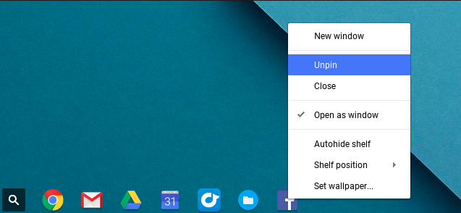
The Shelf
Notes:
Pin things that you use often
Unpin things that you do not want students to use

Slide 8
The Shelf
Notes:
Pin things that you use often
Unpin things that you do not want students to use

Slide 9
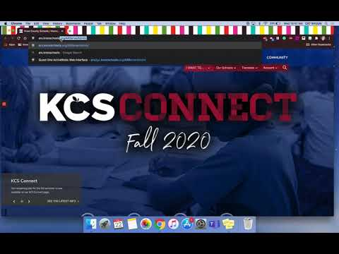
Management...
Sample Student
Reset a Student Password
John Smith
Student ID #1234567
Username: S1234567@student.knoxschools.org
Password: JS4567kcs

Slide 10
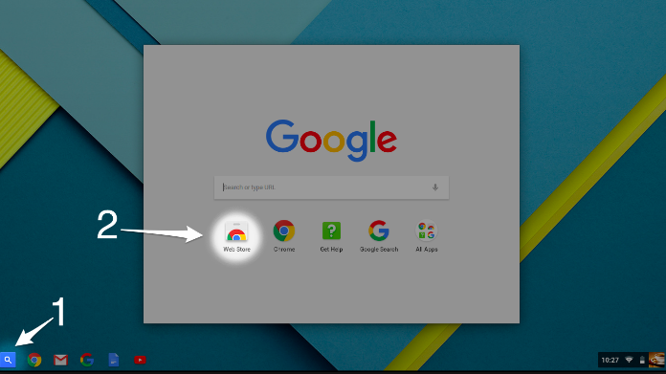
The Web Store

Slide 11
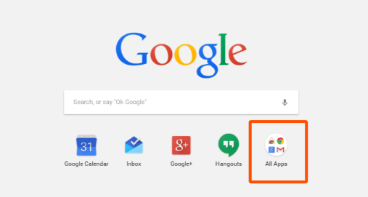
Finding Apps

Slide 12

Suggested Apps
Snap and Read
reading tool to meet
student needs

Slide 13
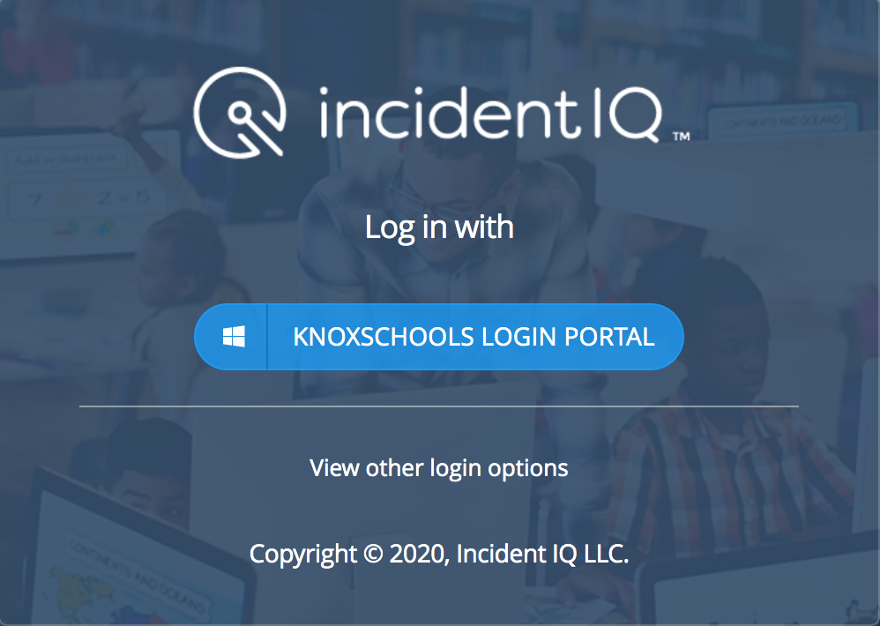
HELP?
Restart the device
Put in an IncidentIQ Ticket
Email your OSTR
Who is the On-Site Tech Resource (OSTR)? - Main point of contact for tech issues at the school, submit tickets on behalf of others in the building, attend a few basic trainings

